Slide 1
Simple Mutiplayer Server
Chenyun Fu Student Nr. 39224996

Slide 2
Content
Description
Case Study
Architecture of Servers
Designed Features
Techniques used
Demo

Slide 3
Description
Multi-server project
Designed for real-time mutiplayer interaction
Designed for handle user management

Slide 4
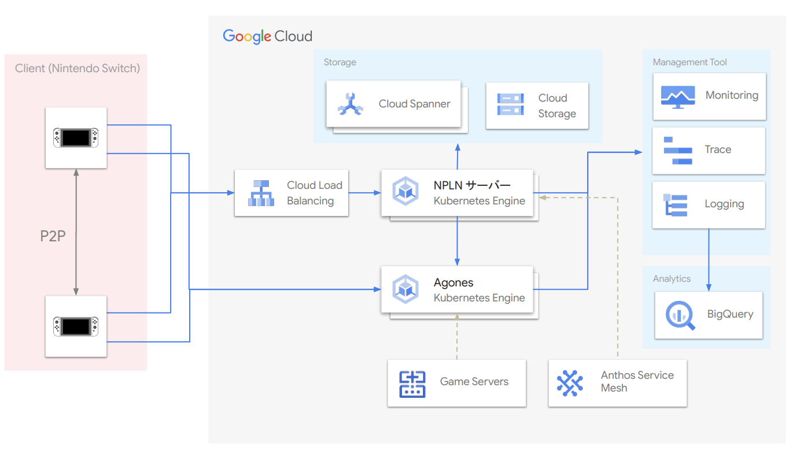
Case Study 1 – Server Architecture
Notes:
Pictures from: https://blog.lxdlam.com/post/24e3aa77/

Slide 5
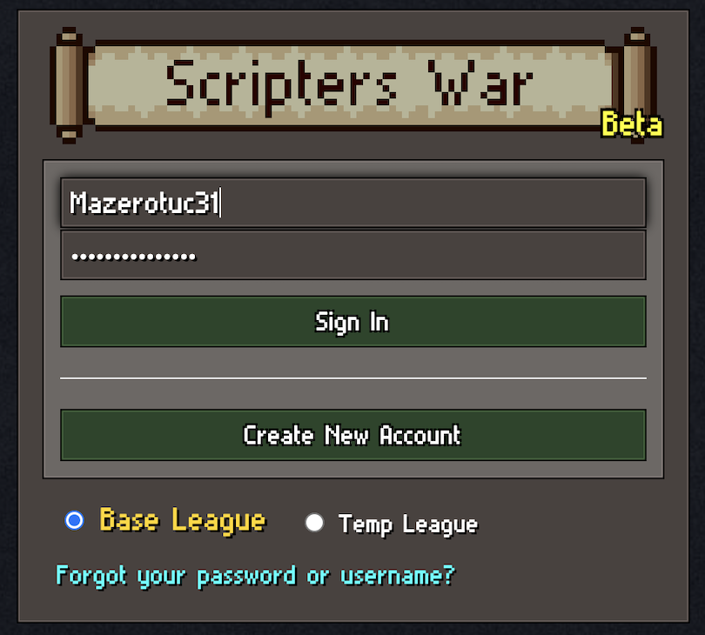
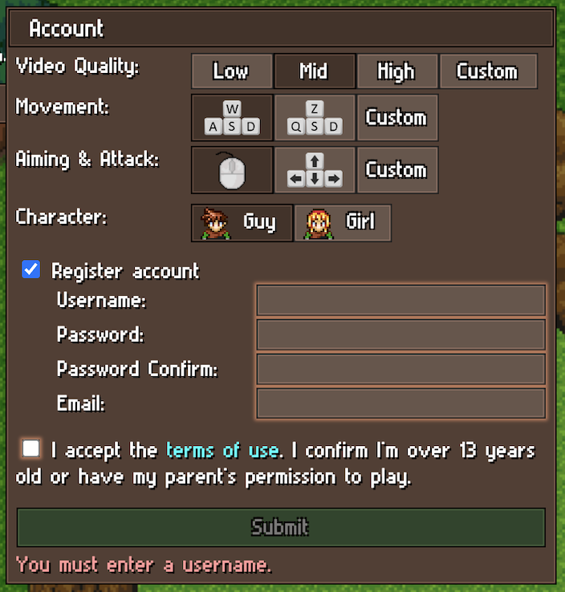
Case Study 2 – Real-Time Online Game
Notes:
Pictures from: https://scripterswar.com/tutorial/nodejs

Slide 6
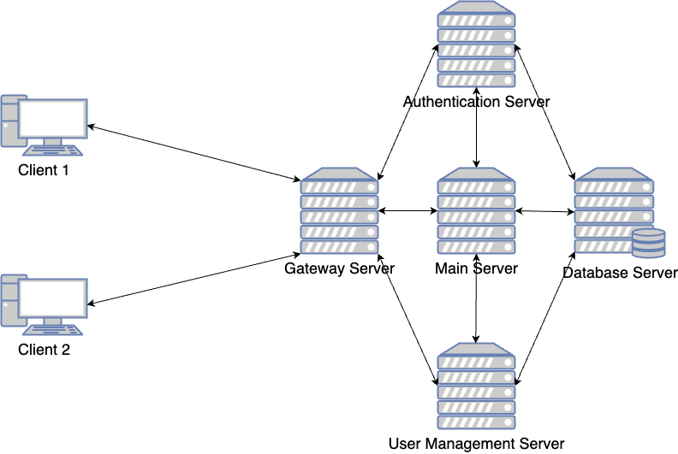
Architecture of Servers

Slide 7

Architecture of Servers
Client and Frontend (HTML)
Gateway Server (Express.js)
Authentification Server (Express.js)
Main Gaming Server (Express.js and Socket.io)
User Management Server (Django)
Database Server (MySQL)

Slide 8
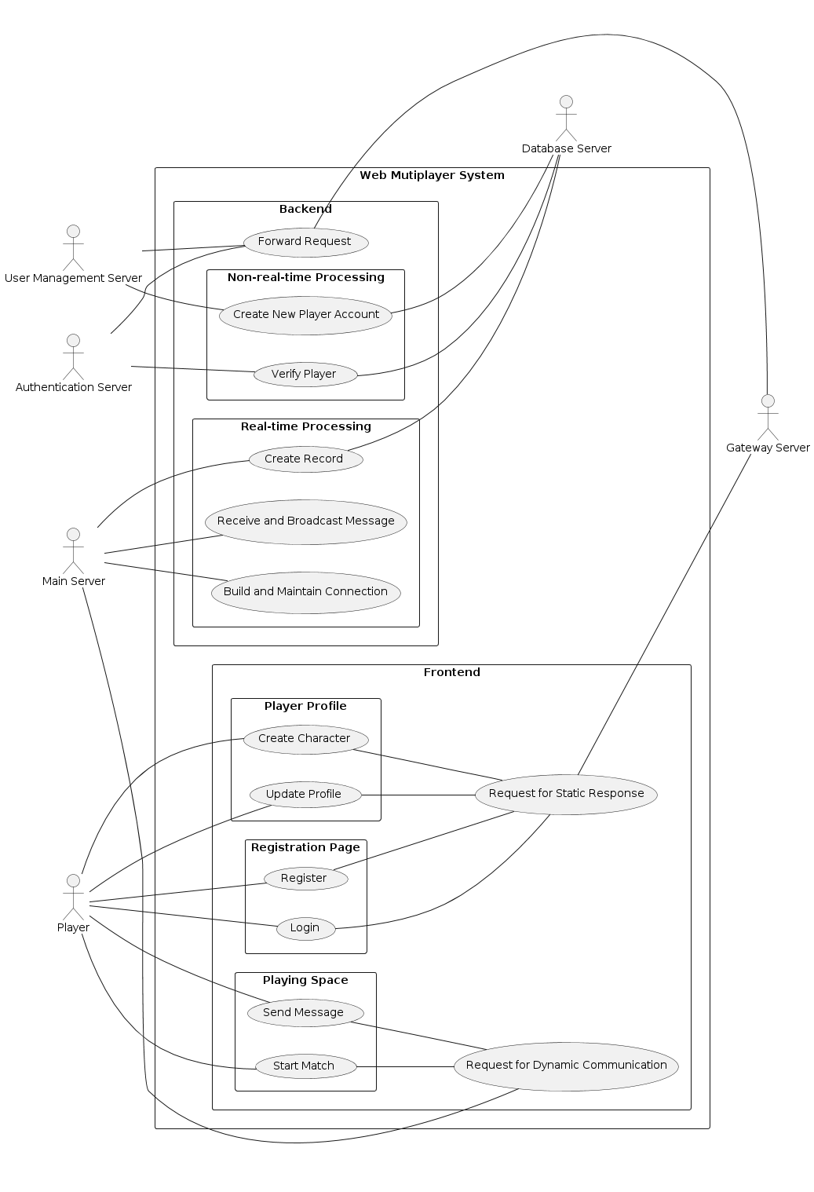
Designed Features
Login, Registration and Authentification
Player Profile
Real-time Gaming and Chat Box

Slide 9
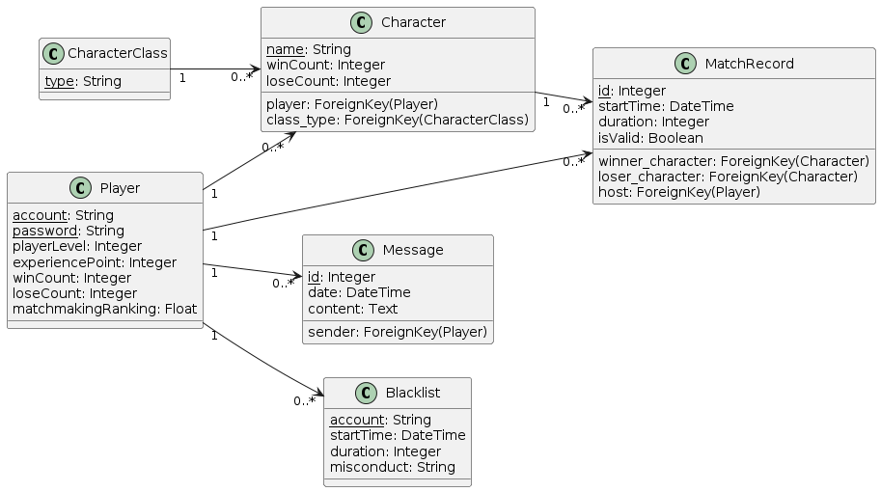
Designed Features
Login, Registration and Authentification
Player Profile
Real-time Gaming and Chat Box

Slide 10
Designed Features – Registration
client:
send request to gateway
gateway:
forward request to user managment server
user server:
process the request and the data package;
send data to database

Slide 11
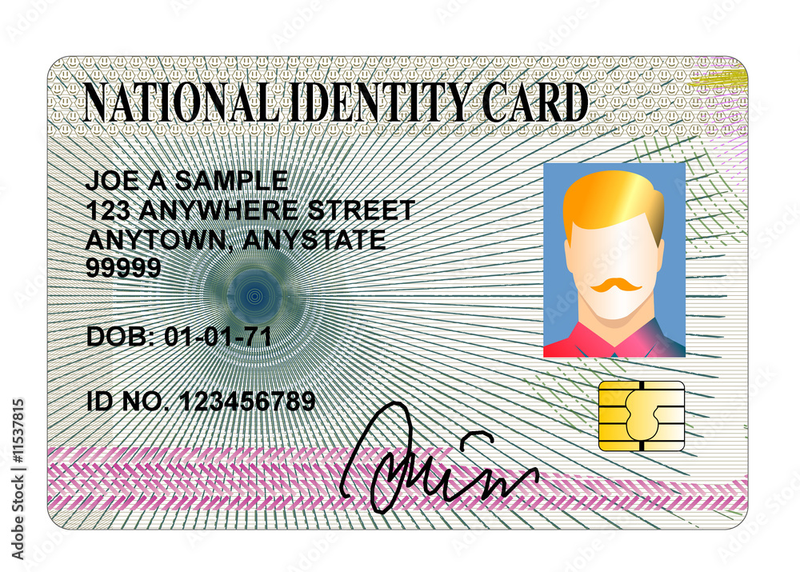

Designed Features - Login and Authentification
Notes:
https://www.pngsucai.com/png/8154480.html https://stock.adobe.com/hk/images/national-id-card/11537815

Slide 12
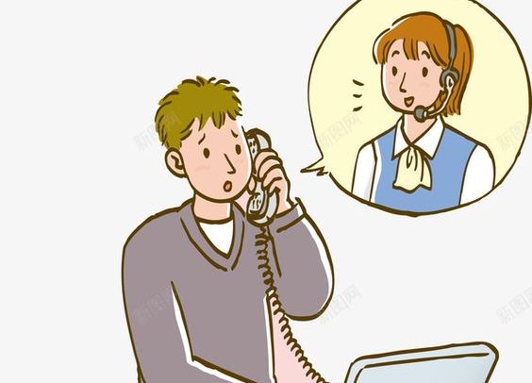
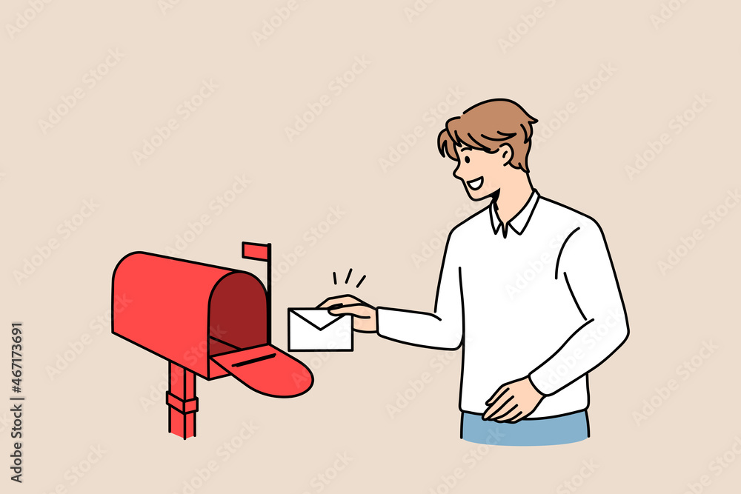
Techniques used - Socket
Notes:
https://www.pinterest.com.mx/pin/683843524667290269/
https://stock.adobe.com/de/images/sending-post-letter-service-concept-young-smiling-man-cartoon-character-standing-putting-envelope-with-letter-into-red-post-office-box-vector-illustration/467173691

Slide 13
Demo

